Slide 1
Paper Review-
Multi-objective Bandits:Optimizing the Generalized Gini Index (ICML 2017)
Robert Busa-Fekete, Balazs Szorenyi, Paul Weng and Shie Mannor
Tan Zhu, Chenyu Zhang, Honglin Wang

Slide 2

Multi-armed Bandit Problem
Player must choose among K options repeatly.
For each selection of option, the player will receive a random reward.
The reward of each option has the corresponding mean.
Notes:
Slot machine

Slide 3
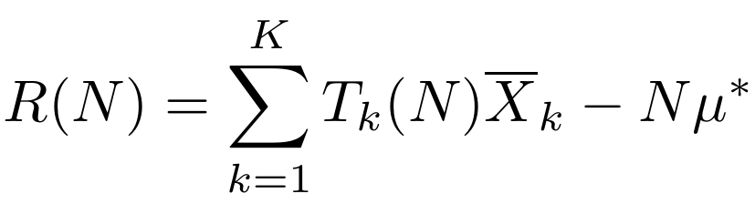

Regret of Multi-armed Bandit Problem
$T_{k}\left(N\right)$ is the number of bandit k is played, where N is the number of all bandits are played.
${\overline{X}}_{k}$ is the current average reward of bandit k.
The mean of reward of the best bandit is $μ^{∗}$.
A policy should be proposed to decrease the regret in the process of selection.
Notes:
Slot machine

Slide 4
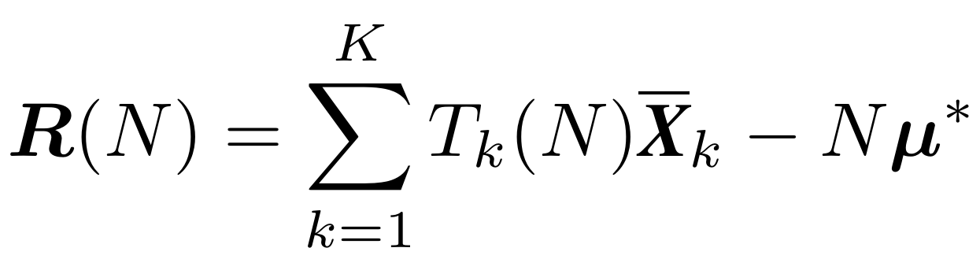

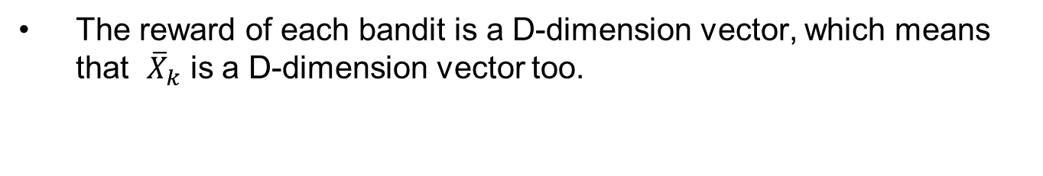
Regret of Multi-objective Bandit Problem
The reward of each bandit is a D-dimension vector, which means that ${\overline{X}}_{k}$ is a D-dimension vector too.
For vector a and b, a is larger than b if and only if each element in a is larger than b.
Notes:
Slot machine

Slide 5
Generalized Gini Index (GGI)
GGI was originally introduced for quantifying the inequality of income distribution in economics.
GGI is a convex function and it could project a vector into a specific scalar value to be optimized.
Surveys have shown that GGI could partially handle the definition comparing vectors mentioned above.
Notes:
Slot machine

Slide 6
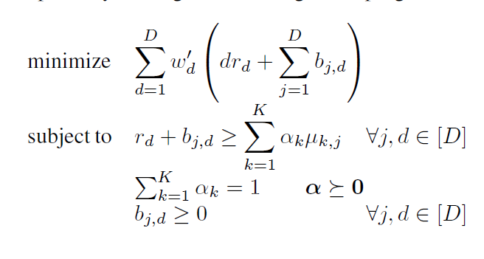
Generalized Gini Index
Ogryczak W, Śliwiński T. On solving linear programs with the ordered weighted averaging objective[J]. European Journal of Operational Research, 2003, 148(1):80-91.

Slide 7
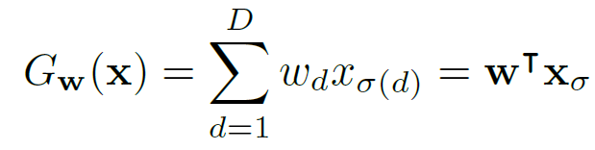


Generalized Gini Index
W is fixed weight.
Is a permutation that sorts the components of x in a decreasing order .
Notes:
W is assumed non-increasing

Slide 8

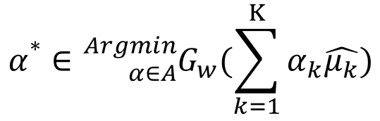
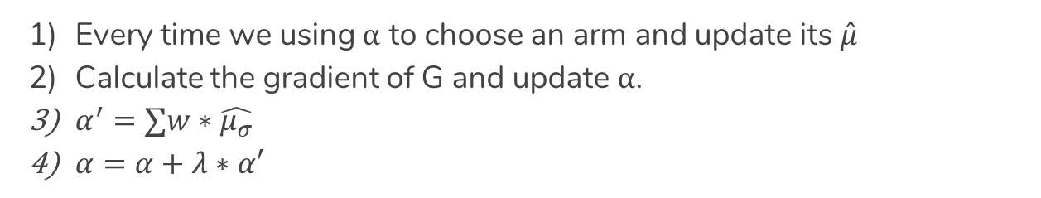
Online Gradient Descent
Every time we using α to choose an arm and update its $\hat{μ}$
Calculate the gradient of G and update α.
$α^{′}=∑w∗\hat{μ_{σ}}$
$α=α+λ∗α′$
Notes:
[ˈsɪmpleks]
specifically ,

Slide 9

Online Gradient Descent
Quadratic programming
$$min dist(α,α^{∗})$$
$$Sub. to ∑α=1$$
$$α≥\frac{η_{t}}{K}$$
Notes:
[ˈsɪmpleks]

Slide 10
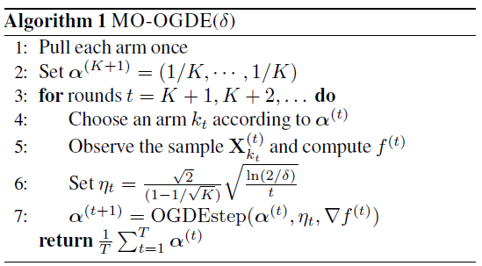
Online Gradient Descent
Notes:
/'i:tə/
[ˈsɪmpleks]
Ita is beta mention in the previous page we could see that ita will become smaller and samller which makes the algorithm allocate less and less iterations on sub optimal arms, because the estimation on the reward of these arms is estimated accurately enough.

Slide 11
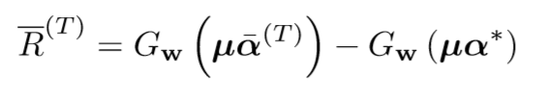
Experimental Results
The regret value can be expressed as a result of the actual expectation of the cumulative cost minus the expectation of the lowest cost
Notes:
Number of arms 2
D dimension of the reward vector 2

Slide 12
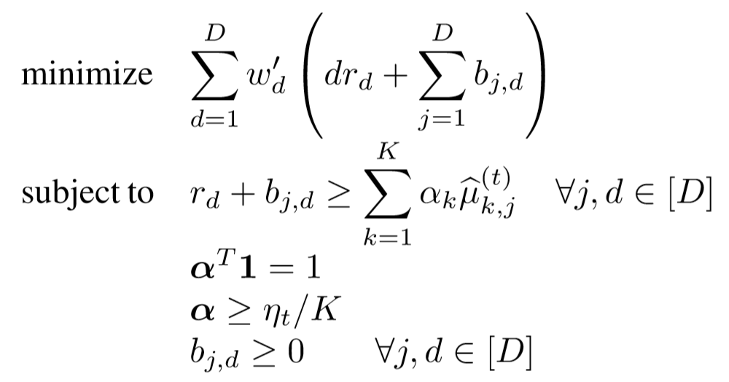
Baseline-Linear Programming
Multi-objective bandits problem can be transferred into the problem of Ordered Weighted Averagers, which could be solved by linear programming method.

Slide 13
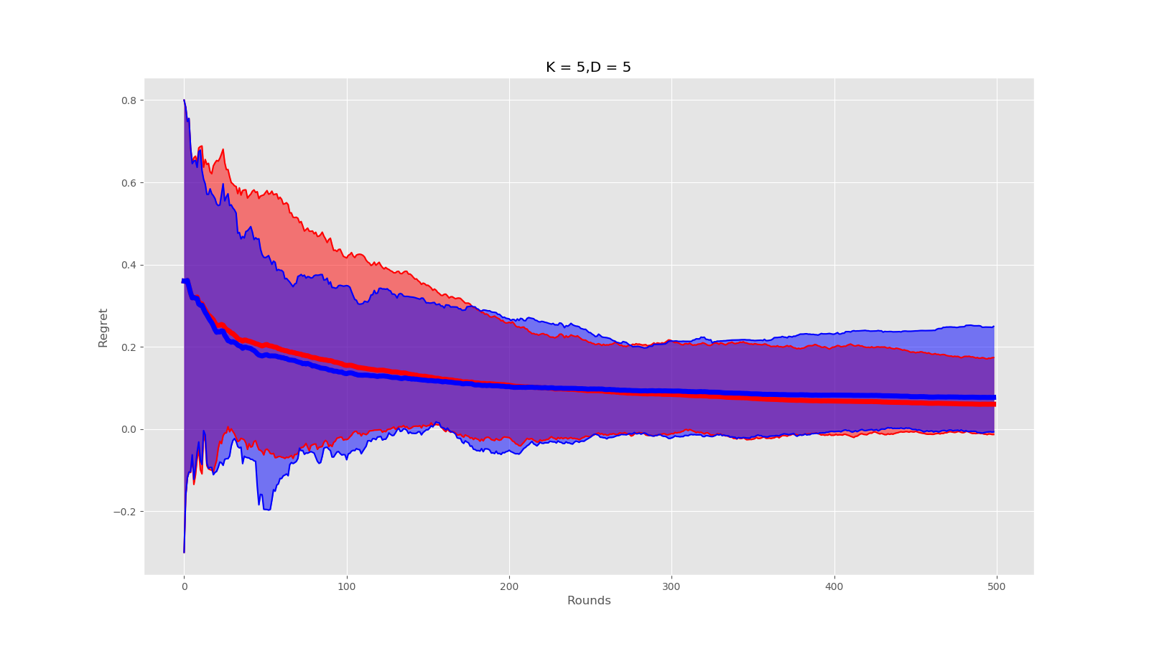

Slide 14
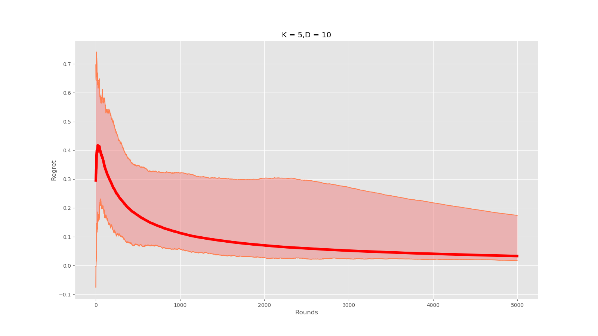
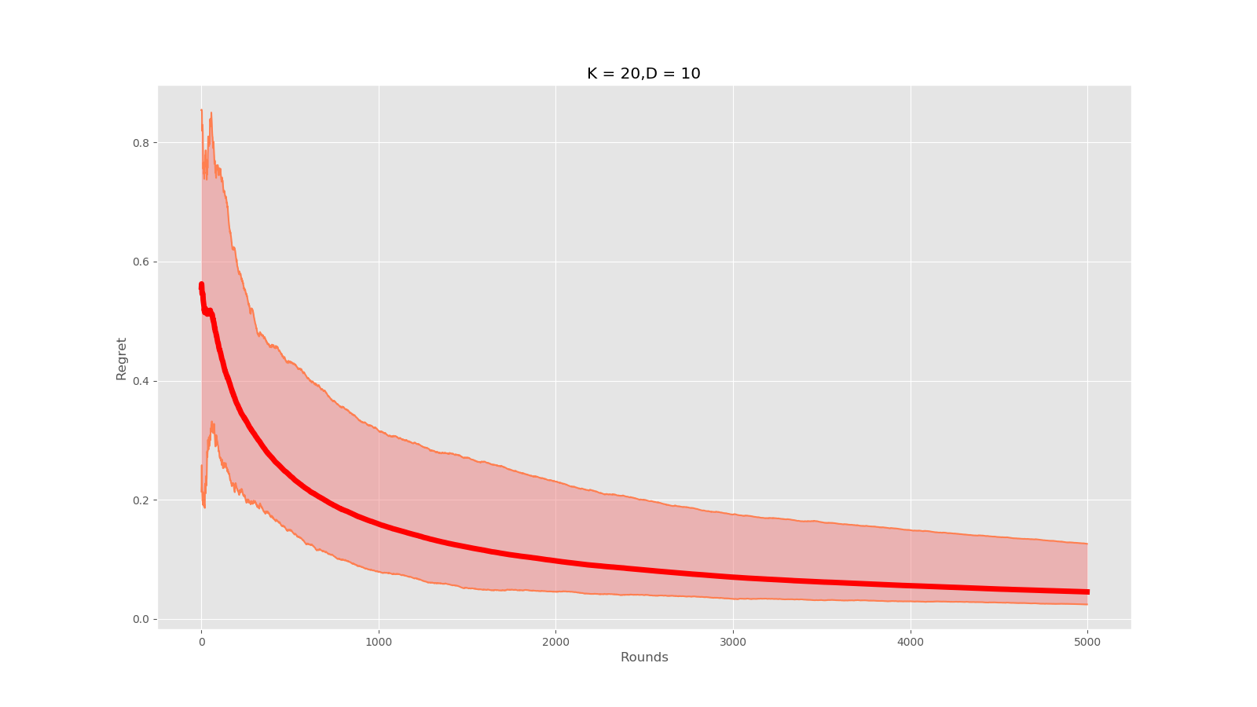
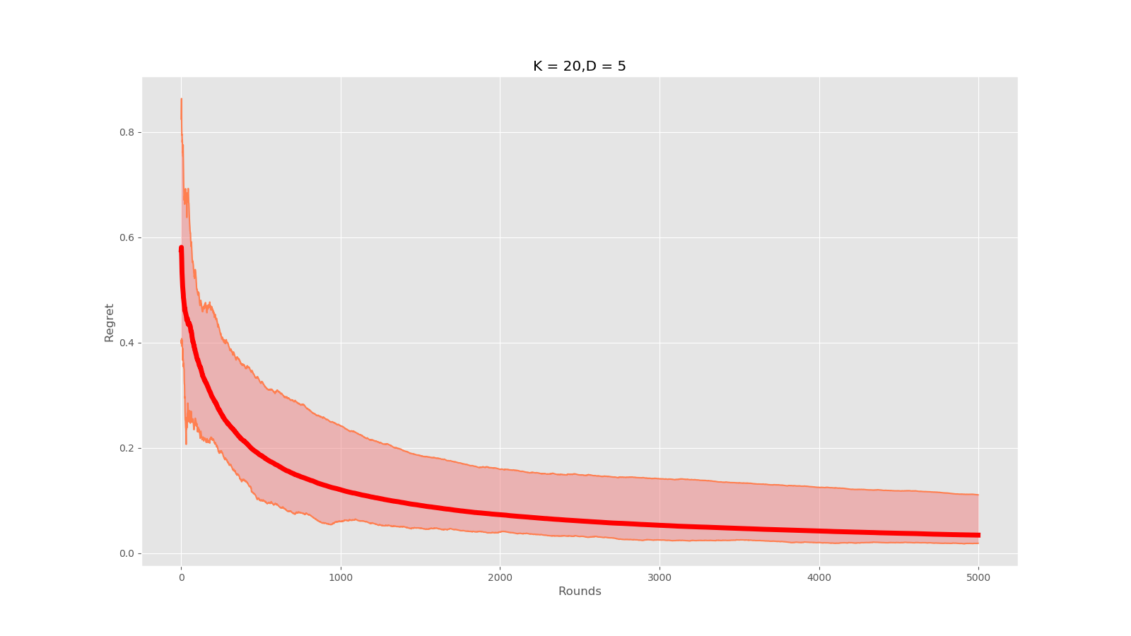
Synthetic Experiments
Notes:
Number of arms 2
D dimension of the reward vector 2

